Slide 1
ECON 611 | Computational Economics
Drew Sandberg
December 7, 2021

Slide 2
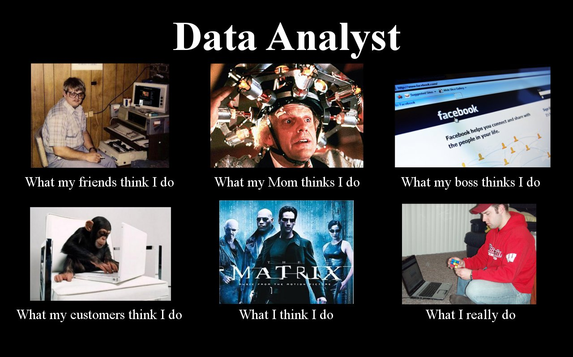
Hi; I’m Drew Sandberg

Slide 3

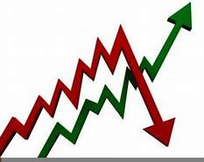
I’ve got an interesting problem to solve

Slide 4
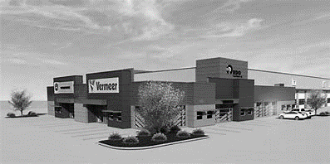
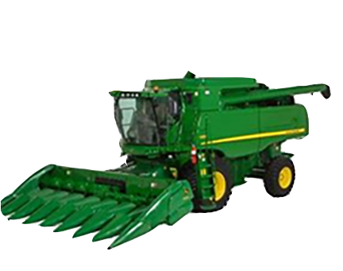
The situation…

Slide 5
What market signals should an equipment dealership company monitor to inform itself that a fundamental change in market conditions has occurred and no longer warrants overpaying for used equipment?

Slide 6
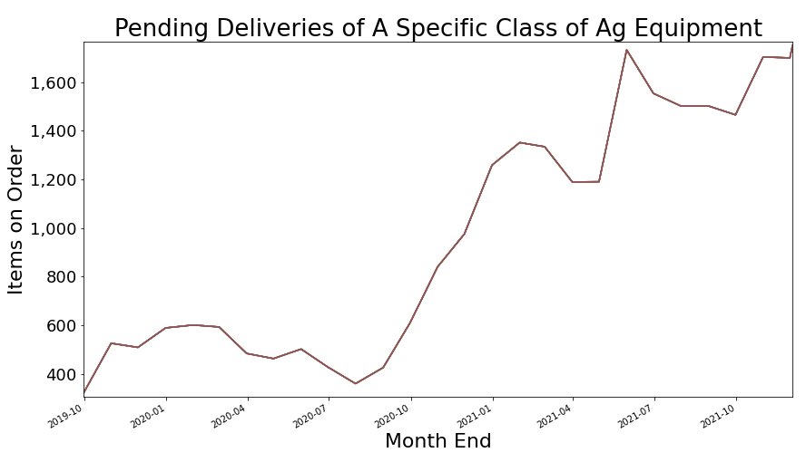

Slide 7
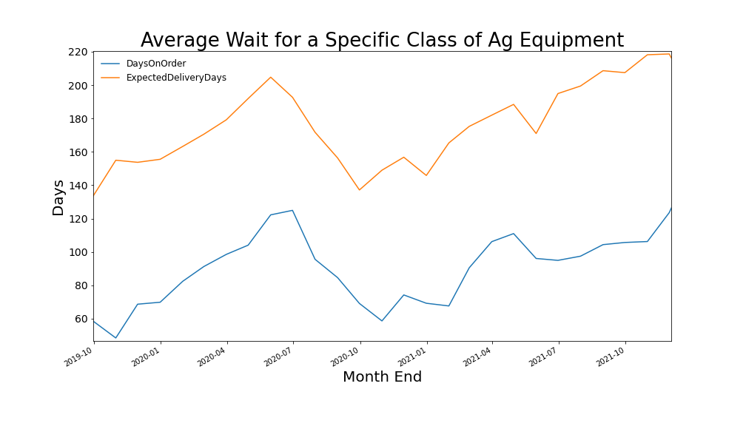

Slide 8
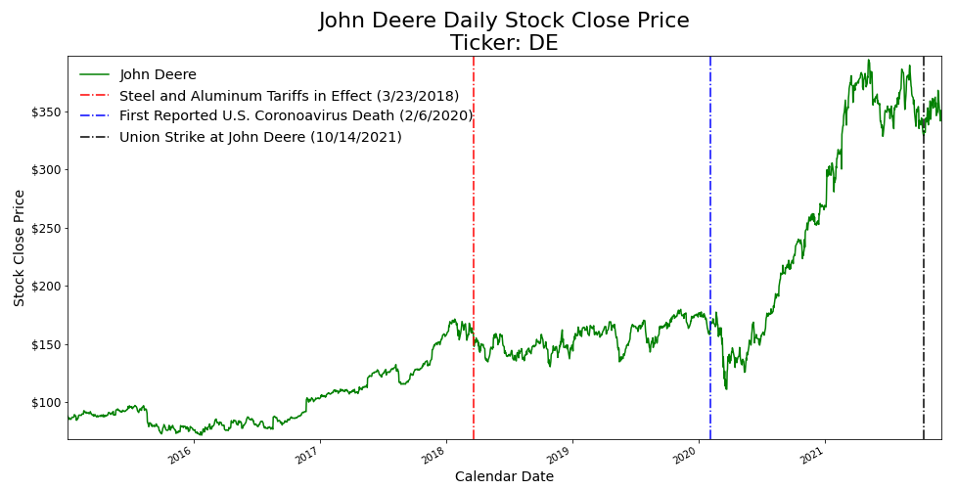

Slide 9
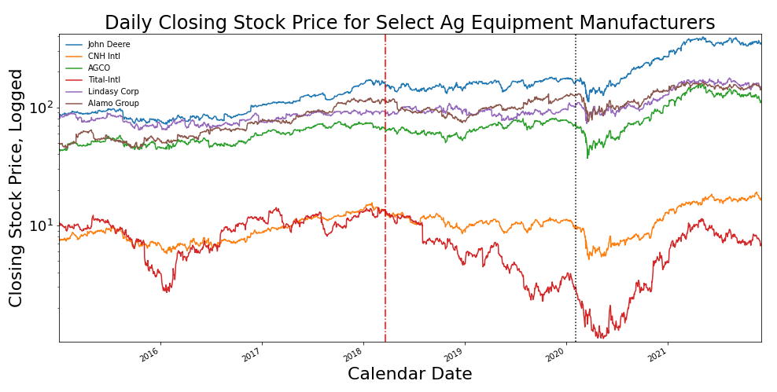

Slide 10
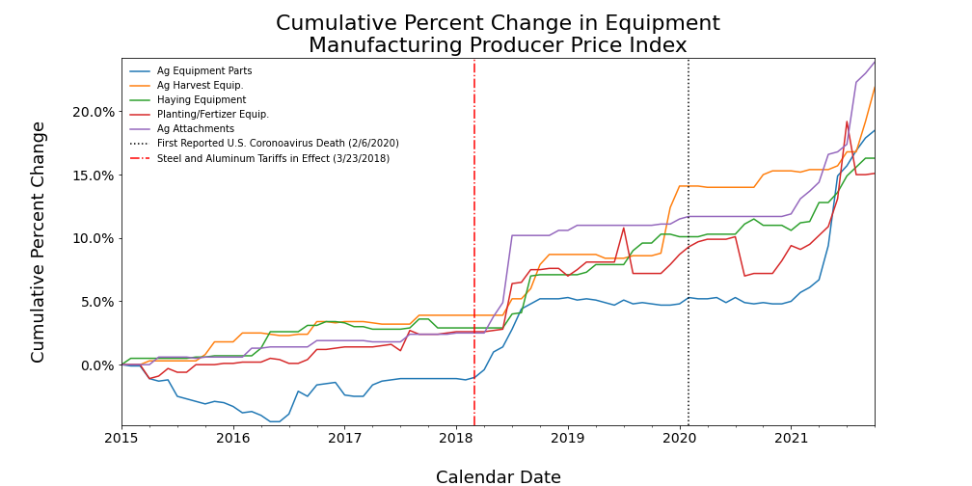

Slide 11
The daily closing stock price for most agricultural equipment manufacturers reflect similar pattern of increases and losses?

Slide 12
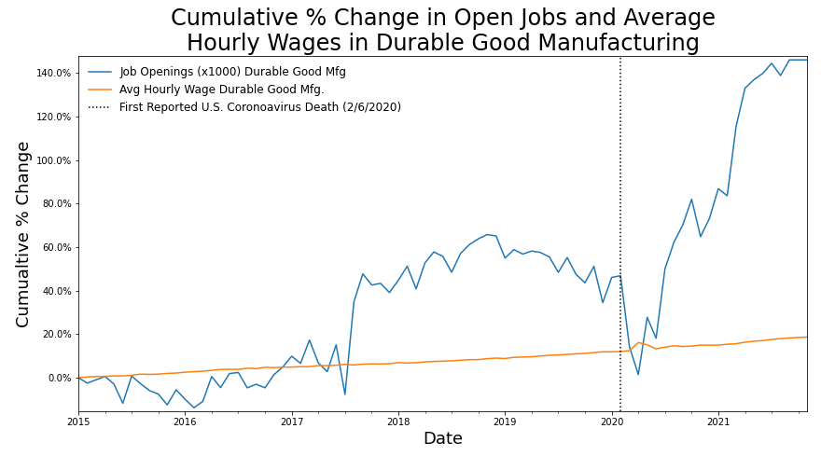

Slide 13
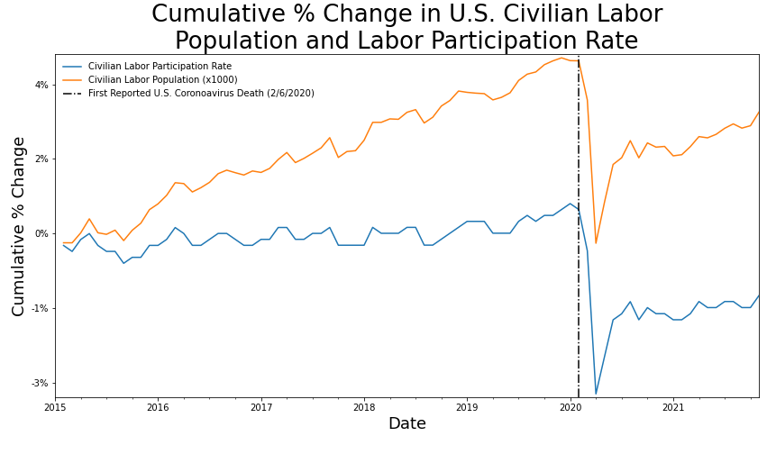

Slide 14
The declining labor participation rate is not a new phenomena.
But curious why a short-term bump in wage during the pandemic regressed to trend line?

Slide 15
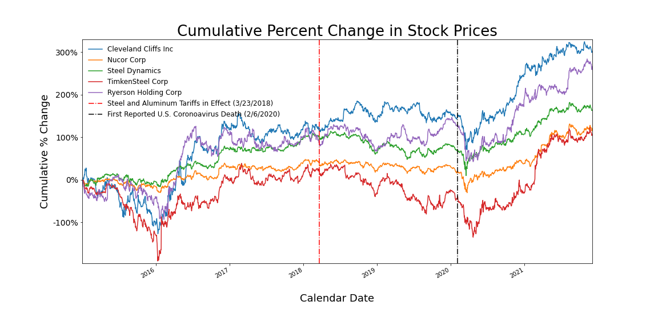

Slide 16
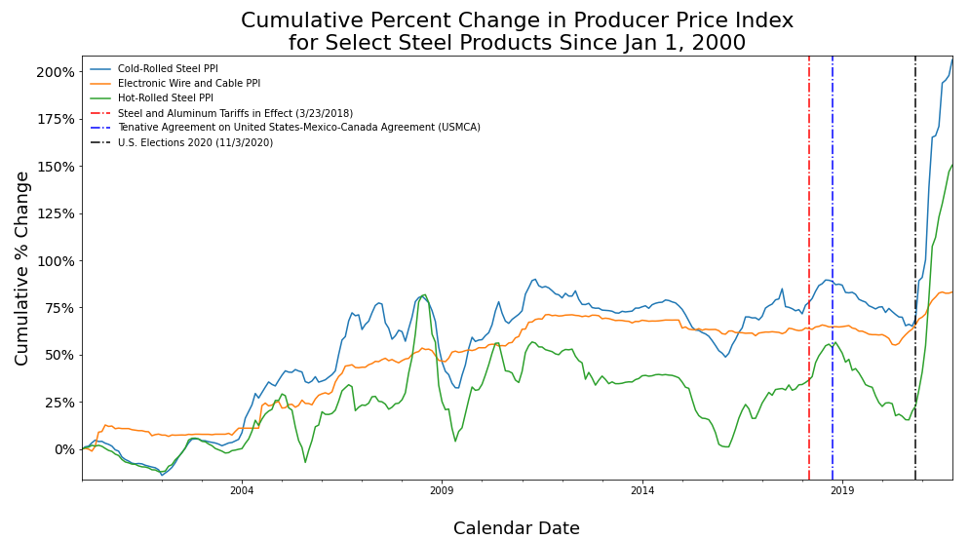

Slide 17
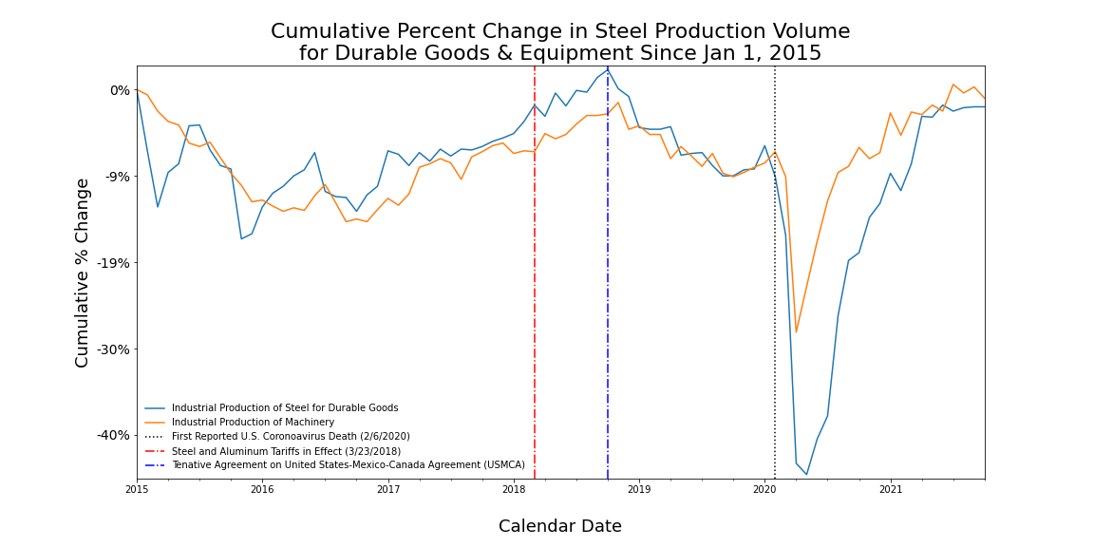

Slide 18
Ag equipment manufacturers: stock prices are up; inflationary pressure on input costs.
Steel companies: stock prices are up; inflationary pressure on input costs, and flat production numbers.

Slide 19
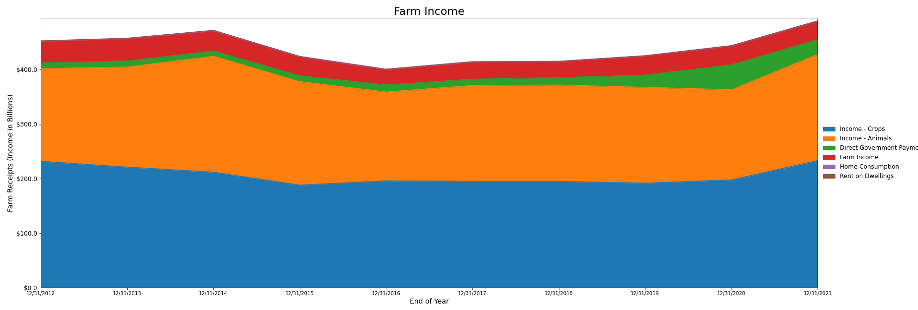
Caution: Low Thrill Zone

Slide 20
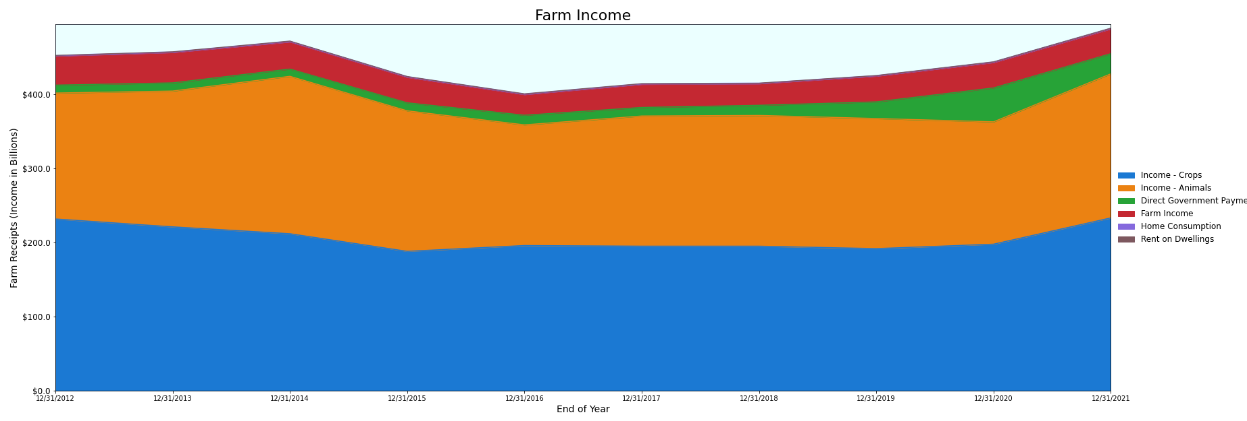

Slide 21
Farm income increases in 2020 and 2021 are related to direct government payments and increased cash receipts for sale of harvested crops.

Slide 22
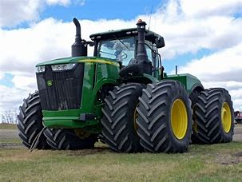
Ag Equipment: Can’t farm without it.

Slide 23


Slide 24
Conclusions
It’s the farm income driving the demand for more equipment.
Direct government payments and commodity supports have propped up farms – no judgement; just stating what the data suggests
Equipment manufacturers stock prices might reflect investors’ assumption that government intervention will lead to more orders for goods
Equipment Dealerships: Watch farm incomes as a more realistic barometer of demand

